Slide 1
Control Flow in R
Control flow refers to the order in which statements and instructions are executed in a program. It allows you to control the flow of the program's execution based on certain conditions, making it possible to perform different actions or make decisions depending on the values of variables or the results of expressions.
Control flow can be achieved using various control structures, such as:
Conditional Statements
Switch Statement
Loops

Slide 2
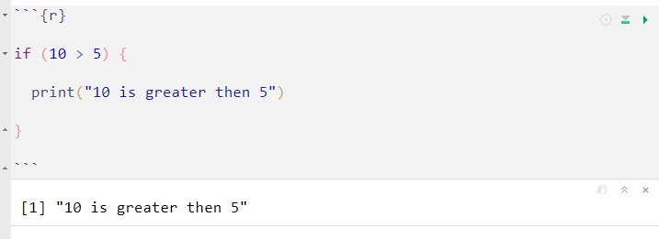
Conditional Statement
Conditional statements are used to control the flow of a program based on certain CONDITION. i.e. They handle the way a program is executed.
The main types of conditional statements are:
IF Statement:
This will executes a block of code if a given condition is true.

Slide 3
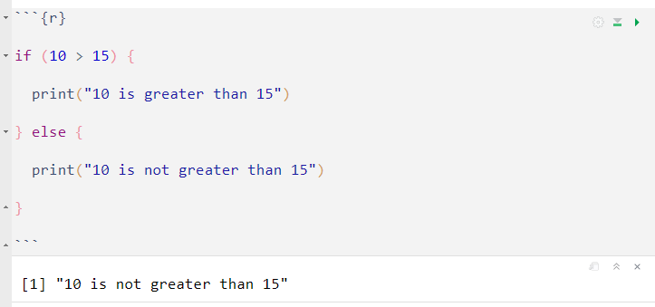
Else Statement:
This will executes a block of code if the condition in the if statement is false.

Slide 4
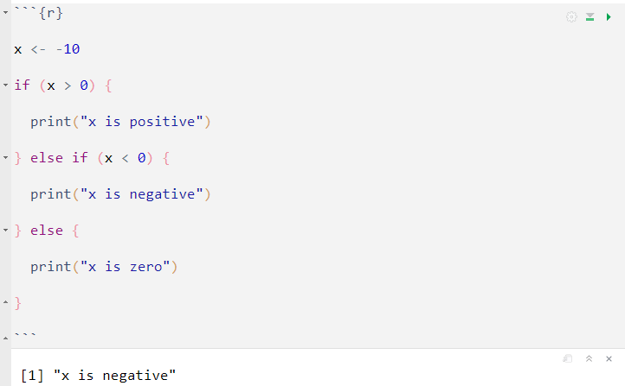
Else IF Statement:
Used to check additional conditions if the previous if condition or (else if condition) is FALSE. If previous condition is false, then it execute the current block of code if it is TRUE.

Slide 5
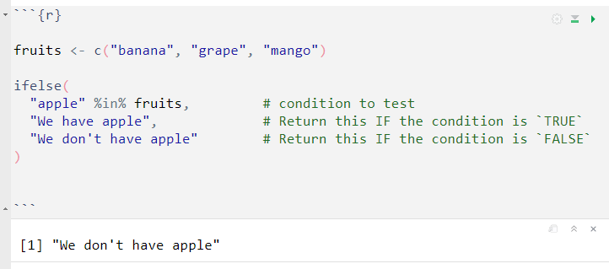
ifelse() function

Slide 6
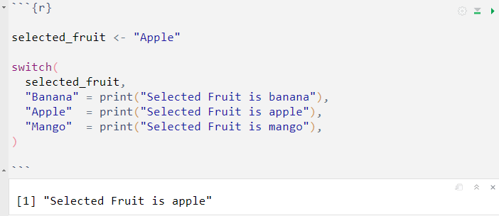
Switch Statement
Using the switch() function, we can select one of several alternatives based on a specific value or expression.

Slide 7
Loops
Loops are programming structures that allows you to execute a block of code repeatedly based on a specified condition. They enable you to perform iterative operative tasks on data or execute a set of instructions multiple times without writing repetitive code.
R support various type of loops, such as:
for
while
repeat

Slide 8
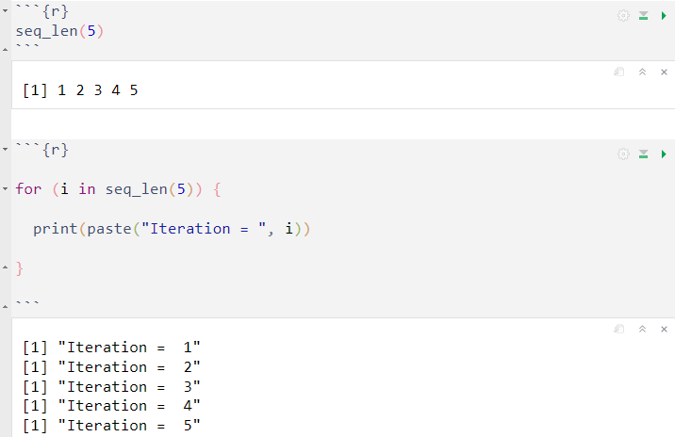
for Loop
A for loop will executes a block of code repeatedly for a fixed number of iterations.
We will use the seq_len() function to generate a sequence of numbers from 1 to 5, which is very effective when iterating over an increasing sequence of integers.

Slide 9
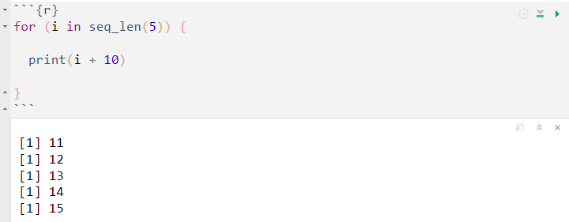
Performing Operations
In the code below for each iteration R will add 10. For example, the first iteration is 1, this will result in 1 + 10 = 11

Slide 10
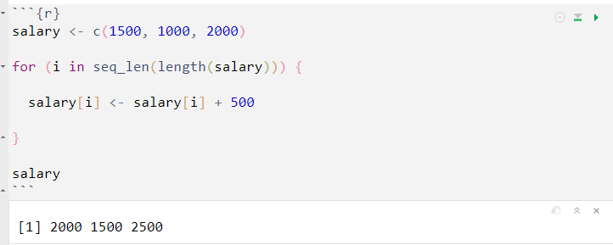
Assignment
When using a for loop, you can perform assignments to update variables or elements of vectors of data structure during each iteration.
let's see a simple example to understand assignment within a for loop. Here we will add 500 to each person salary.

Slide 11
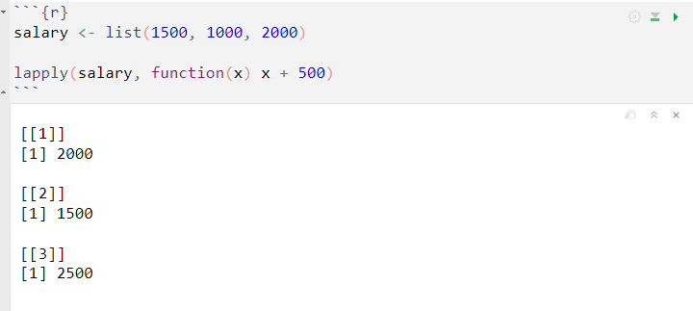
lapply() function
The lapply() function provide a concise and efficient way to perform operations on data structure without using explicit loops. The function will always return a list as output.
In the example above, lapply() applies the anonymous function function(x) x + 500 to each element of the salary list and returns a new list with the addition of 500 to each element in the original list.

Slide 12
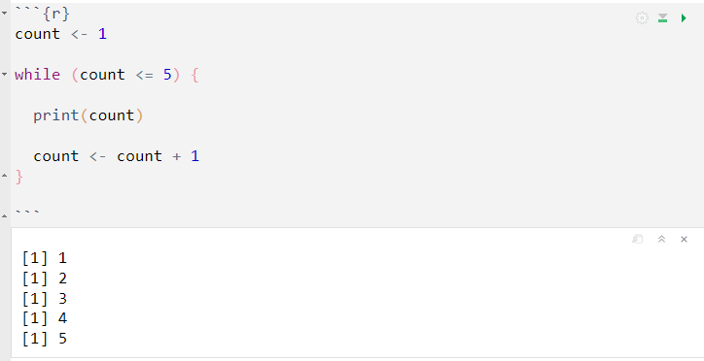
while Loop
A while loop executes a block of code as long as a given condition is true. In other words it will continue to execute a block of code as long as a given condition remains true. It is often used when the number of iterations is not known it advance.
In this example, the while loop runs as long as the count variable is less than or equal to 5. In each iteration, the value of count is printed, and it is incremented by 1.

Slide 13
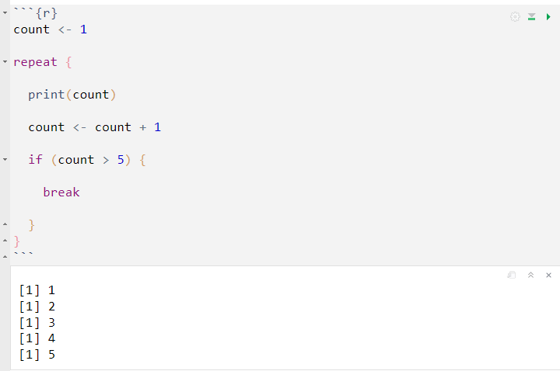
repeat Loop
The repeat loop will continue to execute a block of code indefinitely until a specific condition (usually specified with the break statement) is met.

Slide 14
In the previous example, the repeat loop runs indefinitely, but we use the break statement to terminate the loop when the count variable exceeds 5.

